Slide 1
Global Urbanization and Economic Health of a Nation
By Manoj Dey, Hamed Yazarloo, and Gautam Gupta

Slide 2
Questions
Question 1
Does Urbanization contribute to Economic Growth?
Question 2
How incomes have changed over time in countries across the world ?
Question 3
How large are the differences in GDP between countries?

Slide 3
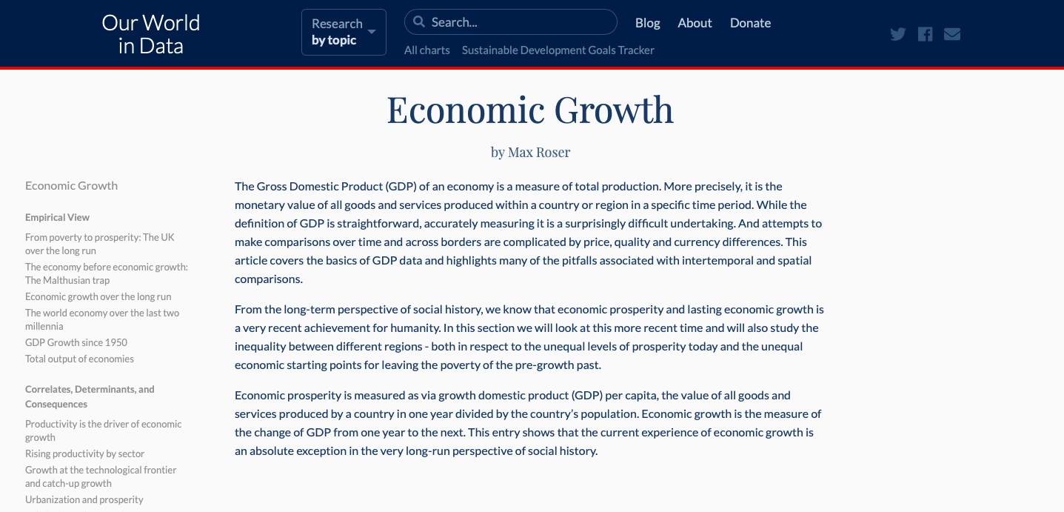
Data
Source: https://ourworldindata.org/economic-growth

Slide 4
Motivation & Summary
Hypothesis 1
Urbanization BRINGS economic prosperity
Hypothesis 2
Economic growth IS a relatively recent development in human history
Hypothesis 3
Economic development IS NOT well distributed across the globe

Slide 5
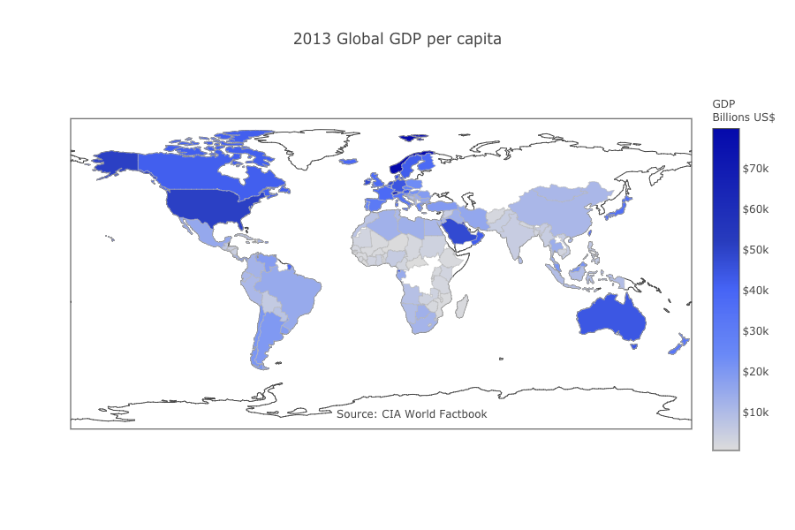
GDP per capita
Notes:
We were able to find our answers and our predictions were shown correct, for each of the three questions we had come up with.
We found for question one (Does urbanization contribute to economic growth?), that urbanization has a positive impact on economic growth.
We have found for question two(How have incomes changed over time in countries across the world?), that incomes have increased .
We found for question three(How large are differences in GDP between countries?) that differences are significant.

Slide 6
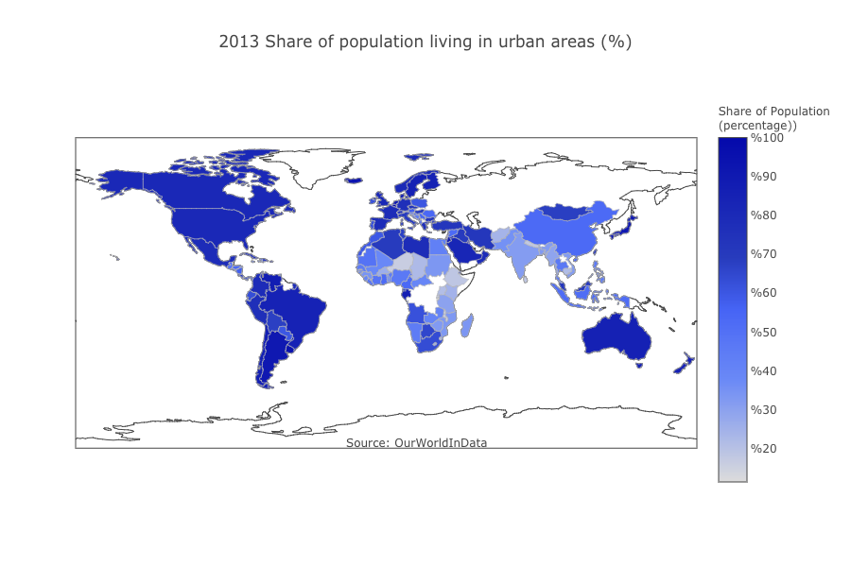
Urbanization
Notes:
We were able to find our answers and our predictions were shown correct, for each of the three questions we had come up with.
We found for question one (Does urbanization contribute to economic growth?), that urbanization has a positive impact on economic growth.
We have found for question two(How have incomes changed over time in countries across the world?), that incomes have increased .
We found for question three(How large are differences in GDP between countries?) that differences are significant.

Slide 7
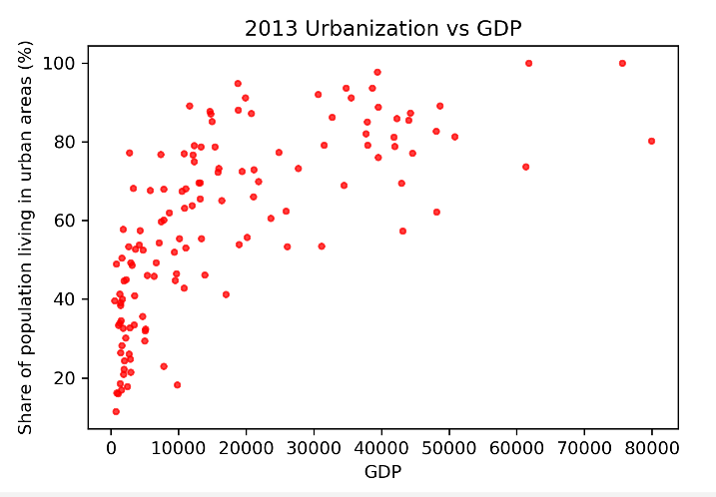
Urbanization vs GDP per capita
Notes:
We were able to find our answers and our predictions were shown correct, for each of the three questions we had come up with.
We found for question one (Does urbanization contribute to economic growth?), that urbanization has a positive impact on economic growth.
We have found for question two(How have incomes changed over time in countries across the world?), that incomes have increased .
We found for question three(How large are differences in GDP between countries?) that differences are significant.

Slide 8
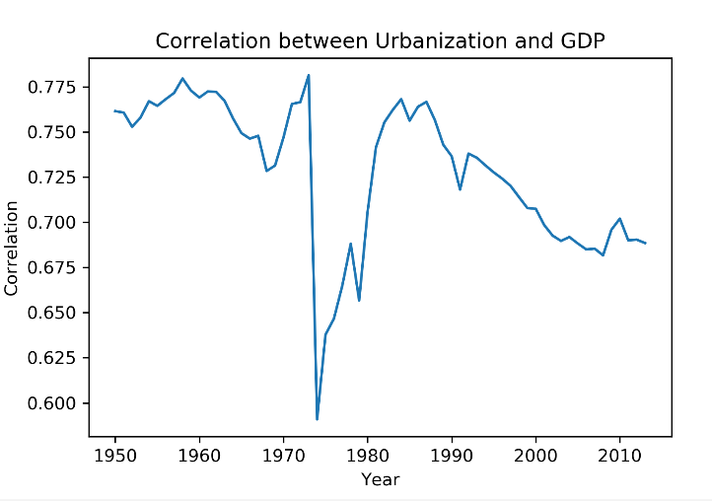
Correlation over years
Notes:
We were able to find our answers and our predictions were shown correct, for each of the three questions we had come up with.
We found for question one (Does urbanization contribute to economic growth?), that urbanization has a positive impact on economic growth.
We have found for question two(How have incomes changed over time in countries across the world?), that incomes have increased .
We found for question three(How large are differences in GDP between countries?) that differences are significant.

Slide 9
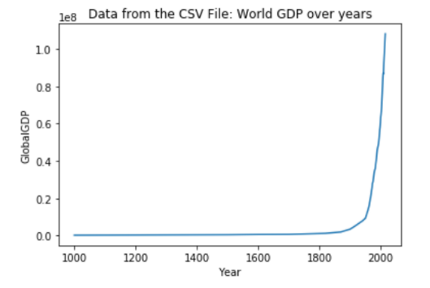
World GDP over years
Notes:
We were able to find our answers and our predictions were shown correct, for each of the three questions we had come up with.
We found for question one (Does urbanization contribute to economic growth?), that urbanization has a positive impact on economic growth.
We have found for question two(How have incomes changed over time in countries across the world?), that incomes have increased .
We found for question three(How large are differences in GDP between countries?) that differences are significant.

Slide 10
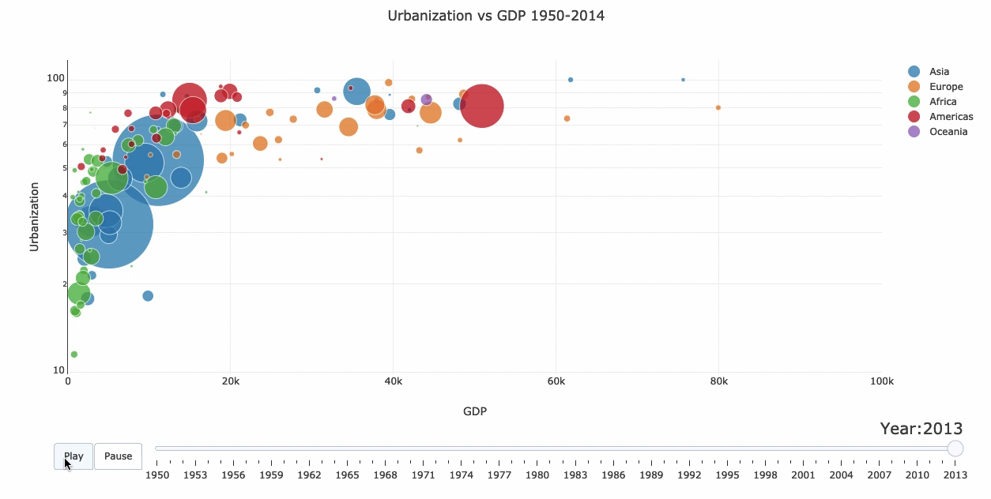
Time, Population, and Continent
Notes:
We were able to find our answers and our predictions were shown correct, for each of the three questions we had come up with.
We found for question one (Does urbanization contribute to economic growth?), that urbanization has a positive impact on economic growth.
We have found for question two(How have incomes changed over time in countries across the world?), that incomes have increased .
We found for question three(How large are differences in GDP between countries?) that differences are significant.

Slide 11
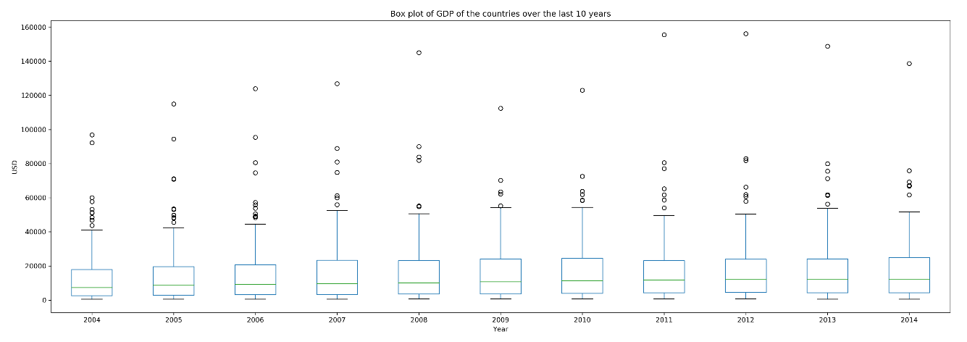
Difference in GDP btw countries
Notes:
We were able to find our answers and our predictions were shown correct, for each of the three questions we had come up with.
We found for question one (Does urbanization contribute to economic growth?), that urbanization has a positive impact on economic growth.
We have found for question two(How have incomes changed over time in countries across the world?), that incomes have increased .
We found for question three(How large are differences in GDP between countries?) that differences are significant.

Slide 12
Data Cleanup & Exploration
Cleanup
Pandas package was used for data cleanup
Exploration
Matplotlib and Plotly modules were used to generate the graphs and maps
Statistics
Stats and Numpy modules were used for statistics and calculations
All of the Data Analysis was done in Jupyter Notebooks

Slide 13

Discussion
Our findings matched our prediction!

Slide 14

Post Mortem
If we had more time in the project, we could maybe have incorporated specific factors that contribute to GDP the most, to have a more narrow analysis.

Slide 15
Questions

Slide 16
Thank you!

